Slide 1
Context-Aware Computing
Context-aware computing refers to a general class of mobile systems that can sense their physical environment, and adapt their behaviour accordingly. Context-aware systems are a component of a ubiquitous computing or pervasive computing environment.

Slide 2
Context-Aware Computing
Adaptive mobile systems
  Application-transparent approach
  Application-aware approach
    Context-aware computing paradigm
Context-aware computing
  adapting to availability of computing and communication resources
  Adapting to context information

Slide 3
context-aware computing
In context-aware computing, the application adapts not only to changes in the availability of computing and communication resources but also to the presence of contextual information, such as
  who is in the vicinity,
  the time of day,
  where the system currently resides,
  the current emotional state of the user,
  the action the user is performing, and
  the intention with which that action is being performed.
A context-aware (or context- sensitive) application requires contextual information that must be gathered from various sources, such as
  sensors that are embedded in the environment,
  devices that are worn by end users,
  repositories of historical data tracking use of the application, and
  information contained in user profiles.

Slide 4
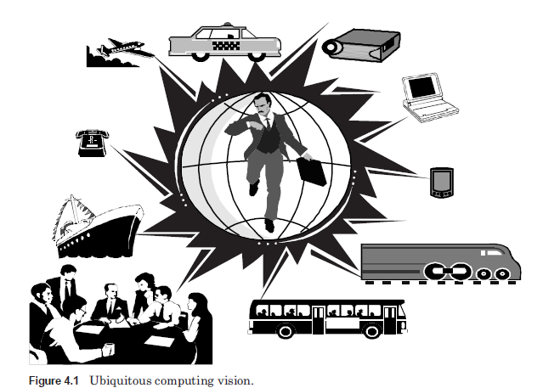
Ubiquitous or Pervasive Computing
The aim of ubiquitous computing is to design computing infrastructures in such a manner that they integrate seamlessly with the environment and become almost invisible.
It concerns mobility of computers as well as mobility of people.

Slide 5
What Is a Context? Various Definitions and Types of Contexts

Slide 6
Context-Aware Computing
Context:
  Enumeration-based (categories) - defined in terms of its various categorizations
  Role-based (roles of context in building mobile applications)
    Active context
    Passive context

Slide 7
Categories of Context - Enumeration-based
Computing context includes network connectivity, communication costs, communication bandwidth, and local resources, such as printers, displays, and workstations
User context includes user profiles, location, and people in the vicinity of the user
Physical context includes lighting and noise levels, traffic conditions, and temperature
Temporal context includes time of day, week, month, and season of the year
Context history is the recording of computing, user, and physical context over time

Slide 8
The 5 W’s…
Who is the user? Who are the people with which the user is interacting, or who is nearby?
  social context
What is the user doing?
  Function context
Where is the user? Home? Work? Bathroom? Familiar coffee shop?
  Location context, the most widely used type of context
  Raw location or higher level
When? What time is it?
  Temporal context
Why? Why is the user performing a certain task?
  Motivating context, one of the most difficulty type of context
Low-level vs. High-level details

Slide 9
The 5 W’s…
Low-level
  Can be sensed directly using sensors or through simple processing
  E.g., by accessing a database, room temperatures
High-level details
  Involve the amalgamation of low-level context information and sophisticated processing
  Social situation, activities

Slide 10
Role Based
Based on this definition, two types of context can be identified.
Active context is the contextual information used by the application to adapt its behavior,
Passive context is the contextual information that is not critical for application adaptation but is provided to the user to enhance his or her understanding of the situation

Slide 11
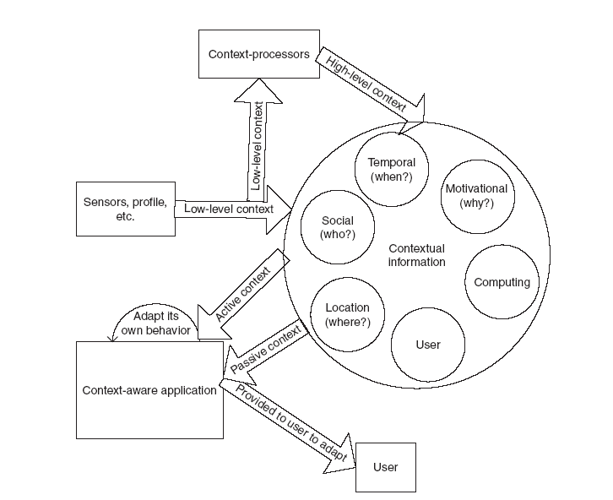
Context Overview- Various types of context

Slide 12
Context-Aware Computing & Apps
Context-Aware Computing Devices & Applications - Mobile applications
  User’s context changes frequently
  Need context-aware behavior
Capability & Features
  Proactive in acquiring contextual information
  Adapt their response based on the acquired info (Reactive)

Slide 13
Context-Aware Computing and Applications
Context-aware computing devices and applications respond to changes in the environment in an intelligent manner to enhance the computing environment for the user (Pascoe, 1997).
Context-aware applications tend to be mobile applications for obvious reasons:
  (1) The user’s context fluctuates most frequently when a user is mobile, and
  (2) the need for context-aware behavior is greatest in a mobile environment.
At a minimum, context-aware applications should be proactive in acquiring contextual information and adapt their response based on the acquired information.
The response itself can be proactive (automatically initiated by the system or application) or reactive (in response to the user’s request).
A context-aware application can perform various tasks, which may include providing a context-aware user interface, presenting contextual and non contextual information to the user, context-sensitive information services, and either proactive (such as automatic reconfiguration) or reactive (such as context-sensitive querying) context-aware adaptation of behavior.

Slide 14
Context-aware Requirements - Core capabilities for context awareness
Contextual sensing
  detection of environmental states
Contextual adaptation
  capability of the system to adapt its behavior by using contextual information
Contextual resource discovery
  capability to discover available resources in an environment
Contextual augmentation
  capability to associate contextual information with some digital data
  Example: association of a particular meeting place and attendees with a set of minutes
  Example: association of a digital photo with a specific location

Slide 15
Types of Context-Aware Apps
Types of Context Awareness Applications - According to Schilit, Adams, and West (1994), context-aware applications can be classified along three different dimensions: function or service type, initiating agent, and adaptation
  Function or Service Type
    Providing information
    Actuating commands
  Initiation
    Explicitly by the user (manual) - The context-aware application either can be initiated explicitly by the user (manual) or can be invoked implicitly by the application.
    Invoked implicitly by the application (auto) -
  Adaptation (contextual selection) - Adaptation performed by a context-aware application consists of various types:
    Information
    System
    User Interface
    Command (behavior): IF-THEN rules

Slide 16
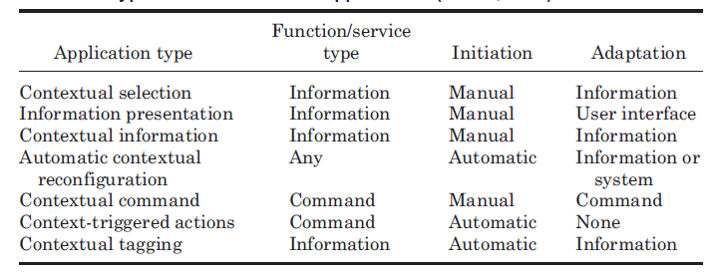
Types of Context-Aware Applications (Schilit, 1994)

Slide 17
Context-Aware Computing & Apps
Developing Context-Aware Applications
the following steps are used for developing context-aware applications:
  Identifying relevant context – application dependent
  Specifying context-ware behaviors: considering reuse
  Integrating with mechanisms for acquisition of contextual information – platform dependent

Slide 18
Context-Aware Computing & Apps (cont.)
Specifying Context-aware Behaviors
  Reuse
  Two Example Approaches
    Context-triggered actions
    Stick-E notes

Slide 19
Context-Aware Computing & Apps (cont.)
Specifying Context-aware Behaviors
  Context-triggered actions
    Active Badge Location System
    Watchdog and contextual reminder for active badges
    System configuration files – parameters, (location, action) in the format:
      Badge location event-type action
    Watchdog Monitoring Events – invoke Actions:
      Arriving
      Departing
      Settle-In
      Missing
      Attention

Slide 20
Context-Aware Computing & Apps (cont.)
Specifying Context-aware Behaviors
  Stick-E Note (Brown, 1995; Pascoe, 1997) motivated by Post-It note
  Supporting platform
    For PDA with wireless connectivity to a communication network
    Equipped with various sensor: GPS, etc
  Major components
    Context
      Location, nearby users, time (where, who, when)
    Content
      Information
      Actions
      Interfaces

Slide 21
Context-Aware Computing & Apps (cont.)
Stick-E Note (Brown, 1995; Pascoe, 1997)
  Position sensing
    Active badge system
    GPS
    Beacons, cell phones, bar-codes scanners
  Standard Generalized Markup Language (SGML)
    <note> tag
    <at> tag
    <body> tag
    <optional> tag

Slide 22
Stick-E Note Example
<note>
<at> “Noble Engineering Library”
<body>
Pick up the book from interloan library section.
-------------------------------------------------------------------------------------
<note>
<at> “Noble Engineering Library”
<optional>
<triggering-frequency> once
<body>
Pick up the book from interloan library section.

Slide 23
Middleware Support
The main complication in developing context-aware applications stems from the very nature of contextual information:
1. It is acquired from various heterogeneous and distributed sources:
  a. Hardware and software sensors—obtained from various sensors, such as motion detectors, noise and temperature sensors, and location systems.
  b. System recorded input—such as user-system interaction history. Context information history is essential for applications such as context-based retrieval.
  c. Other applications:
    i. User’s personal computing space—such as those obtained from schedules, calendars, address books, contact lists, and to-do lists (Satyanarayanan, 2002).
    ii. Distributed computing environment—such as those obtained from applications running in the vicinity of these devices, e.g., services provided by the infrastructure of a shopping mall or freeway system.

Slide 24
Middleware Support
2. The same type of contextual information may have to be obtained from different sources at different times.
  For example, a mobile device’s location information may be acquired from GPS receivers if the mobile device is outside or from an indoor positioning system if the mobile is inside a building.
3. The low-level contextual information obtained directly from sensors must be abstracted to be useful to the application.
  As an example, GPS receivers provide location information in terms of latitudes and longitudes.
4. Context awareness is most relevant when the environment is highly dynamic, such as when a user is mobile.
  Changes in the context must be detected in real time and conveyed to the applications as soon as possible so that the applications, particularly those using context triggered commands and contextual automatic reconfiguration, have ample time to adapt their behaviors.

Slide 25
Contextual services
1. Context subscription and delivery service. A service to which applications can subscribe that delivers context events back to the applications.
2. Context query service. A service for applications to query current context.
3. Context transformation service. A service that transforms low-level contextual information into high-level contextual information. More generally, it transforms contextual information in one form into contextual information in a form suitable for an application.
4. Context synthesis service. A service that fuses various types of contextual information.
5. Discovery and management service. A service that helps in the discovery of available services and manages all the sensors and software components used by these services.

Slide 26
Actuator service
An actuator is a service that helps an application perform a context-dependent output function.
Example:::The Context Toolkit, created at Georgia Tech, is developed around the paradigm of widgets, similar to GUI widgets used for developing graphic user interfaces (GUIs).
It is an object-oriented framework that allows retrieval of contextual information through polling and callbacks. The toolkit provides several software components that a software designer can use for context acquisition:
1. Context widgets. A context widget is a software component that provides context acquisition and delivery service. widget serves as an interface between sensors and applications.
2. Context interpreters. A context interpreter provides a context transformation service to the application. For example, a tourist guide application can use an interpreter to convert GPS data to street names.
3. Context aggregators. Aggregators merge context data from various sources (context widgets and interpreters) to represent context that is associated with an entity. An entity can be a person, room, another software system, or a hardware device, among many possibilities.
4. Discoverer. A discoverer provides discovery and management services for sources of contextual information.

Slide 27
Providing location context
Example: A location information system (LIS) provides location information to the application. ALIS locates objects representing either a person or resources inside areas (Spreitzer and Theimer, 1993).
A LIS can obtain location information about the user from various sources:
  1. Indoor locating systems such as infrared-based active badges or ultrasound-based bats
  2. Wireless nanocell communication activity
  3. Outdoor locating systems such as GPS
  4. Device input activity from various computers
  5. Motion sensors and cameras
  6. Explicit information from the user.

Slide 28
Several issues relate to providing the location information of the user.
  First and foremost is the issue of privacy.
The accuracy of the location information. There are two aspects to this: spatial resolution and temporal resolution of the locating system.
  Spatial resolution depends on the accuracy of the underlying sensing technology.
  Temporal resolution depends on such factors as how frequently LIS updates the location information of each user and how sensitive the sensing technology is (e.g., how small a change in someone’s location can the sensing technology detect).

